Slide 1
Work with us: what’s in it for you?
Jersey Employment Trust & Back to work

Slide 2
Agenda
Introduction
Back to Work
Jersey Employment Trust
Q&A
Key takeaways

Slide 3
Introduction
Back To Work:
Financial incentives for employers
The Foundations Program
Training and development schemes
Jersey Employment Trust:
Our service
Training, work experience and internships
In-work support/job retention

Slide 4
Back to Work
Approach and offerings

Slide 5
Career Ladder
Discuss your own career journey

Slide 6
Within the Goals program we discuss the Career Ladder
Where did you start your first job? Discuss in groups
What led to your better job? Discuss in groups what led to your better job
What would your ideal job look like? Share in groups
What type of training, opportunities and skills would you need to get your ideal job? Discuss and share in groups
Map out one person’s Career ladder experience within your group on the flip chart paper provided.

Slide 7
Training
Industry Training- Care, Business Administration, Hospitality training and Customer service training
Goals programme: Learning about the keys to success, building self-esteem and motivation and job seeking skills
Internal workshops: customer service, personal branding, confidence in the workplace, CV writing, Talent link tips, interview skills
Decider Training: Developing coping skills to help with mental health, and how to make changes which will impact positively on your day to day life
Interview Skills: Tips, advise and practice on how to prepare for interviews, tackling different interview questions with confidence
Best of you: Identifying personal development needs to propel you forward into creating a better version of you as a person
IT skills: Developing IT skills to upskill and increase knowledge using technology and software programs.
Back to Work Training programmes

Slide 8
Foundations Schemes
Scanning
Retail
Construction/Painting & Decorating
Environment
Back to Work paid training initiatives

Slide 9
Foundations cont’d
Back To Work offer this program for clients who have been out of work for a period of 6 months or longer and have certain barriers affecting them to go straight into paid employment
Depending on the work flow that they choose the duration lasts between 3 and 6 months
Our clients are paid the minimum wage and gain experience in the different areas that they choose to work. This also gets them into a work routine ready for fully paid employment.
Professional and personal development

Slide 10
Who Foundations work with
To name but a few of our partnerships

Slide 11
Paid incentives
Back to Work Recruitment act as a recruitment service. We help to source and match candidates currently registered with Back to Work to vacancies in businesses as well as advertising these roles on the Gov.je website.
Paid Training:
To be eligible the candidate must have no previous experience in the area the job role is in
The employer must provide a 12 week training plan and a contract to cover the training period.
6 month Employment incentive:
We will cover the wage of the employee for the first 12 weeks of employment at minimum wage as well as the 6.5% employer contributions
Employment Incentive (gov.je)
Paid Training
Employment incentives

Slide 12
Access to work scheme
'Access to Work Grant’ is offered to people in employment who may need specific aids or equipment to help them start work, return to work or remain in work, which we can help people to apply for. More information about this can be found on our website - Access To Work Grant (gov.je).

Slide 13
Jersey Employment Trust
Approach and offerings

Slide 14
Introduction
The Jersey Employment Trust works with anyone with a disability or long-term health condition to help them with their training or employment goals and provide guidance and support.

Slide 15
Work Experience
Why a work experience?
We can help by:
Supporting job trials and work placements
Providing advice, guidance and support to both the client and the employer
JET has an Employment Relations Manager who meets with potential employers to discuss working together
https://www.jet.co.je/employment/clients/training/

Slide 16
Internships
What is a JET Internship?
Benefits include:
Provides an additional team member without the financial impact
Allows a candidate to receive a full induction process and training in an identified area of employment
In 2021 we secured 6 opportunities; 4 of which led to permanent paid work.
https://www.jet.co.je/employment/clients/training/
JET paid training programme
Notes:
As part of our ongoing client training and development programme we offer clients the opportunity to undertake a paid Internship with the ultimate goal of them securing paid work.
As well as providing the client with valuable learning and workplace experience, Internships can be a ideal way for an employer to assess a person's employment skills and suitability for a role without an initial financial impact on the business.

Slide 17
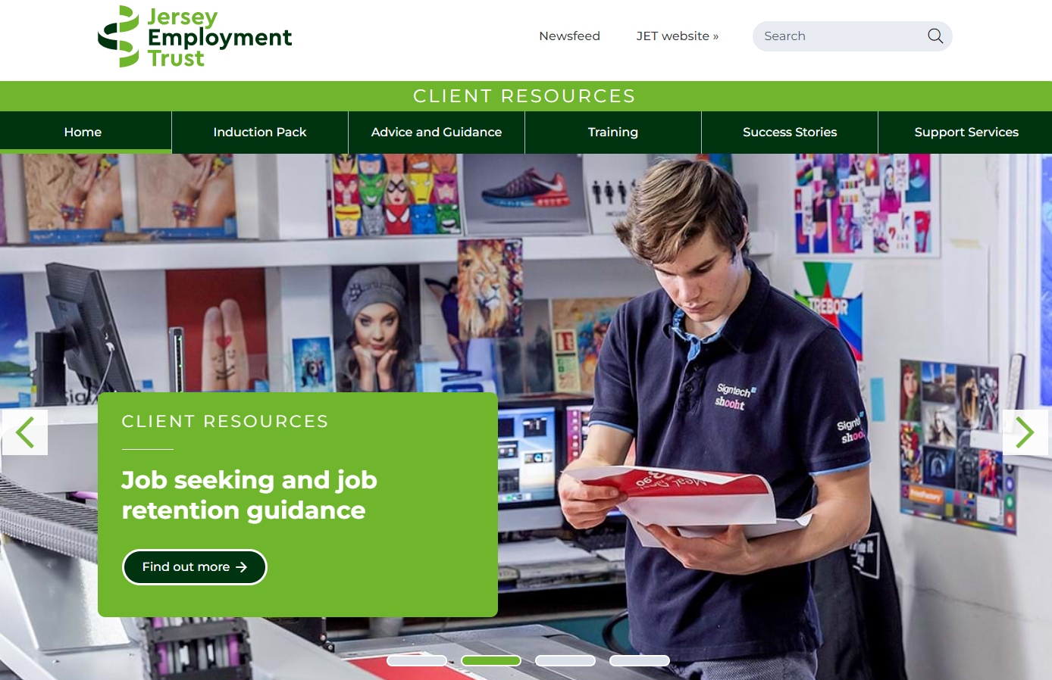
Training & Career Development
Training:
We help identify and source training from external providers, such as Back to Work, ALX Training and Highlands College.
Career Development:
We can support a client to prepare for:
Upcoming workplace reviews or appraisals
Looking for a career change or enhancement
www.jettraining.co.je

Slide 18
In-work Support
What is in-work support?
We offer a bespoke, professional on-the-job support service to clients commencing work.
Agreed between all parties, we can assist clients with:
Support through induction
Developing workplace skills
Formal and informal catch-ups
Support during review meetings
An appraisal process
Job retention
https://www.jet.co.je/employment/employers/in-work-support/
Clients and employers

Slide 19
Job Retention and long-term support
JET can provide support to any person who is finding it difficult to maintain tasks within their current job role due to a new or existing medical or mental health condition, or disability.
Working with clients and employers, we can provide:
Advice on Occupational Health assessments
Role and task assessment
Exploring reasonable adjustments
Assistance with Access to Work grant applications
Facilitating employer/employee meetings
Signposting to relevant advisory or support services
https://www.jet.co.je/employment/employers/job-retention/

Slide 20
14-21 Service
We have a 14-21 service providing opportunities for our young adults.
The aim of this service is to build relationships with students who might benefit from having employment support in the future.
https://www.jet.co.je/employment/clients/14-21s/

Slide 21
Takeaway
What can you offer as an organisation?

Slide 22
Questions?

Slide 23
Thank you
Back to Work
www.gov.je
backtowork@gov.je
Jersey Employment Trust
www.jet.co.je
dean.lowe@jet.co.je

